Slide 1

Hx Wallet
Team Members:-
Guided by
Neama Mamdoh Ramadan Abdelkader
Aya Mostafa Kamel Hashem
Entesar Atef Abdelrahman Omar
Doaa Saadeldeen Yassen Ahmed
Doaa Ahmed Salman Ahmed
Yousef Elsayed Yousef Abdallah
Mohamed Mahmoud Abdeltawab
DR/Ibrahim El-Semman

Slide 2
About the Idea
The idea of ​​this website has not been implemented before in Egypt.
This website preserves the medical history of its users, such as prescriptions, x-rays and medical tests.

Slide 3
Advantages
A way to support the presence of technology in our lives
One of the ways of Data management

Slide 4
Problems to solve
Medical data loss problem
The problem of losing the quality of medical X-rays
It saves space used by paper data
Gives fast access to user’s medical history

Slide 5
We tried to solve the previous problems by creating this website “Hx Wallet” :
The site saves all Medical history data in it and can be accessed easily through the SSN
Seeing prescriptions, x-rays and analyzes added to your page and following up on the results of x-rays and tests
And to Know more about this website Functionality we need to Know the website users
This website has users represented in the doctor, the patient, the pharmacy, the analysis lab, the radiology lab

Slide 6
Patient
The patient can access his medical history through his identification number(SSN). His page that contains his medical data appears when he can access:
the medical tests to show him a list containing all the medical tests he performed and all the medical tests that were described to him ,and when he clicks on any one of them, It shows him the details of this test and its result, whether it arrived or not
The medical x-rays to show him a list containing all the medical X-Rays that he performed and that were described to him ,and when he clicks on any one of them, It shows him the details of this X-ray and its result, whether it arrived or not
All the prescriptions in a list. When choosing any of them, the prescription will appear to him, detailing each drug, its name, dates and dose.

Slide 7
To add x-rays, analyzes and prescriptions to the patient's page:
The patient can go to the doctor to take his SSN and add to him the prescriptions, analyzes and electronic rays and search for any of them
The patient can go to the pharmacy with his national number so that the pharmacist can access his patient history ,and he paid him what he wanted from his own prescriptions that the doctor added to him
He can also go to the laboratories and to enter his page and see the x-rays and analyzes required of him

Slide 8
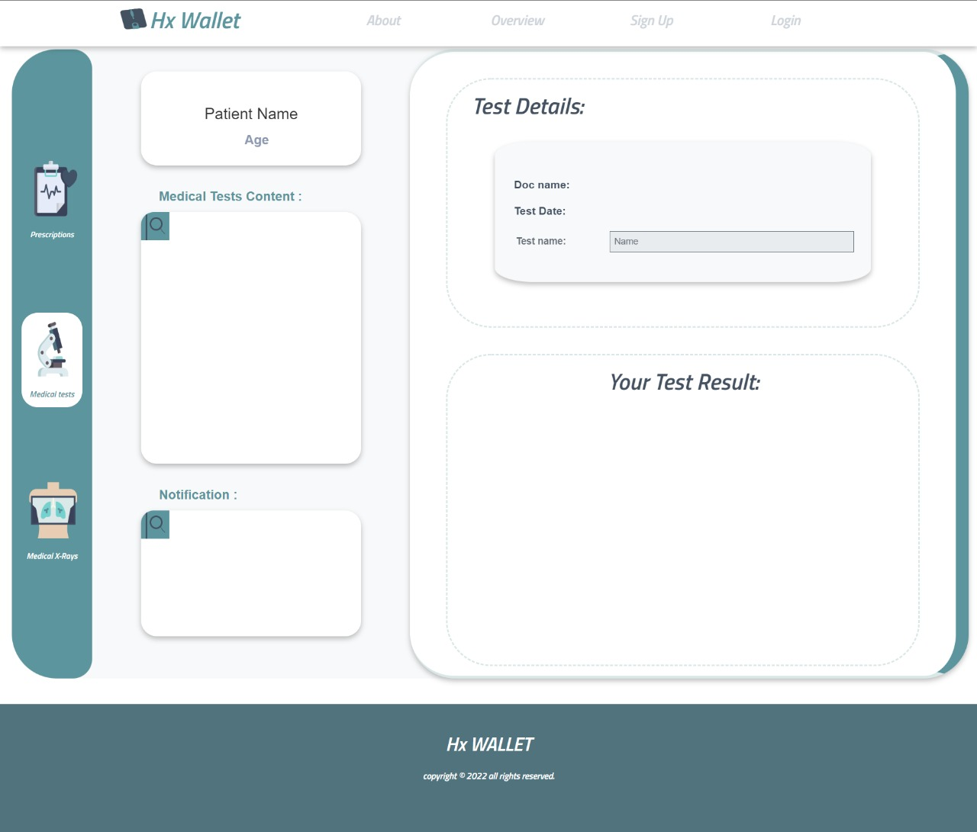
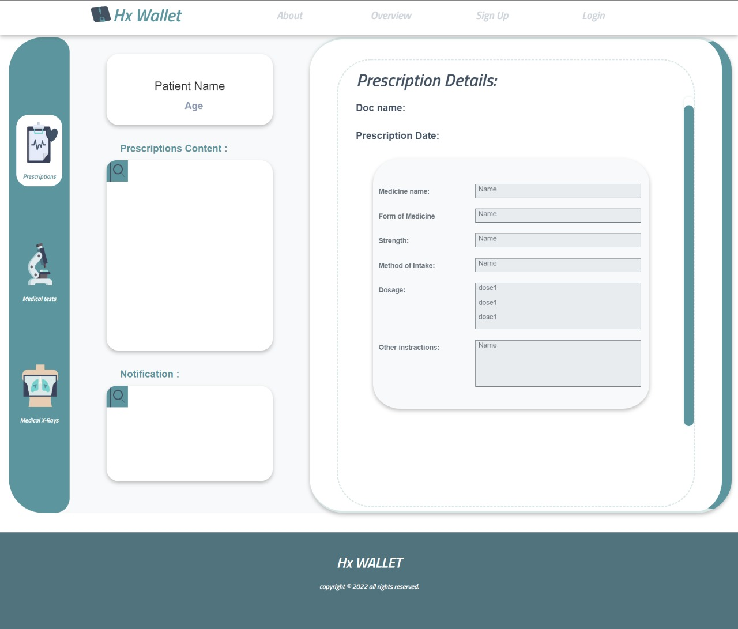

Slide 9
Doctor
Using the patient’s SSN, the doctor can enter to see his medical history from x-rays , tests and prescriptions and search for specific one
He can add new prescriptions by adding medications from a list already on the site for all medications and adding their dates and dose, and add the required tests and x-rays from existing lists to help the doctor tests and x-rays.

Slide 10
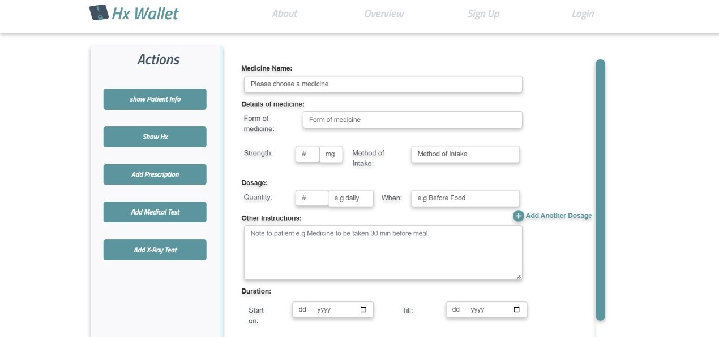

Slide 11
Pharmacy
The pharmacy employees can use the patient’s national number to see a list of his prescriptions and search for specific prescriptions to give him what he wants from them

Slide 12
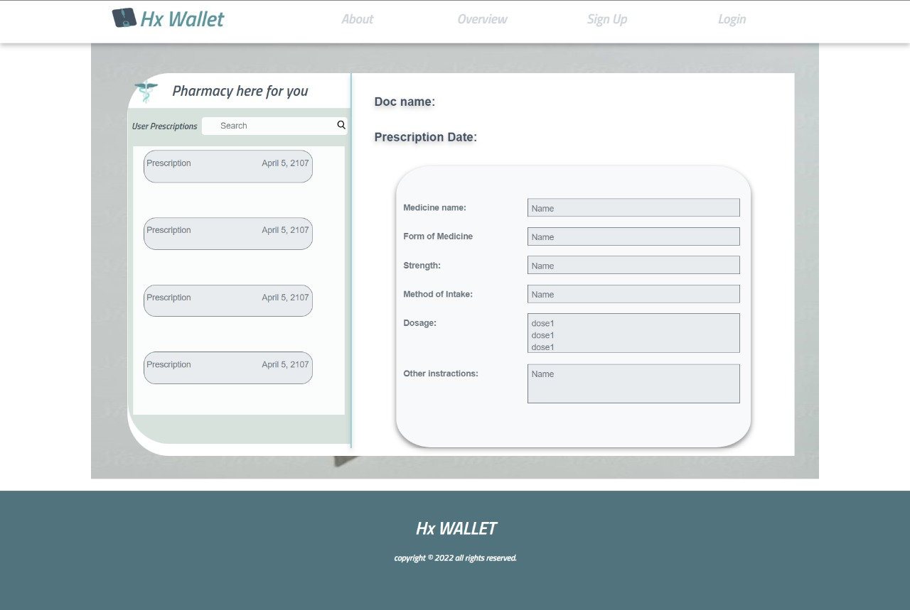

Slide 13
Labs
Laboratory workers, using the patient's national number, can see the x-rays and tests required of him to help him perform them and search for any of them.
After completion, they can send the results of these x-rays and tests to the patient on his page

Slide 14
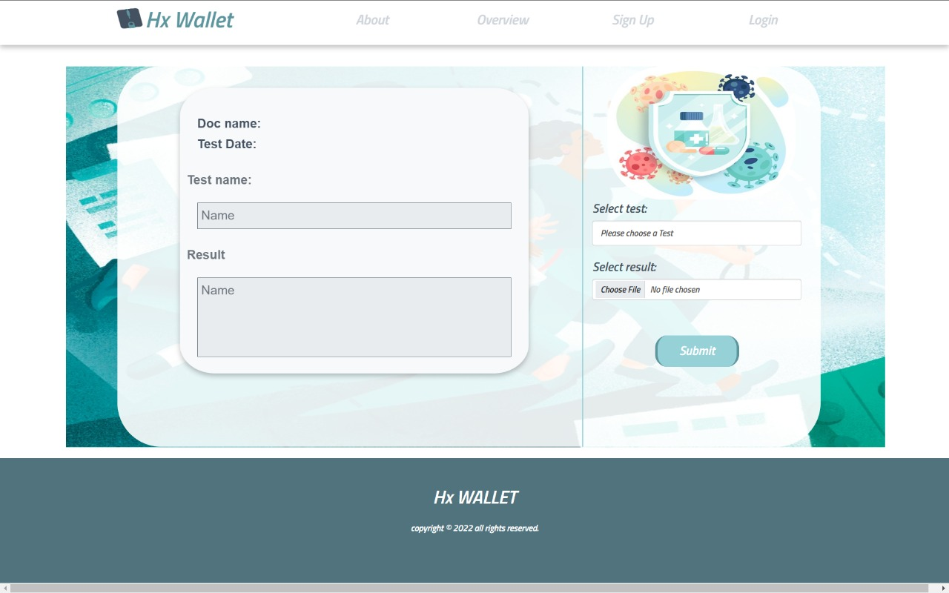

Slide 15
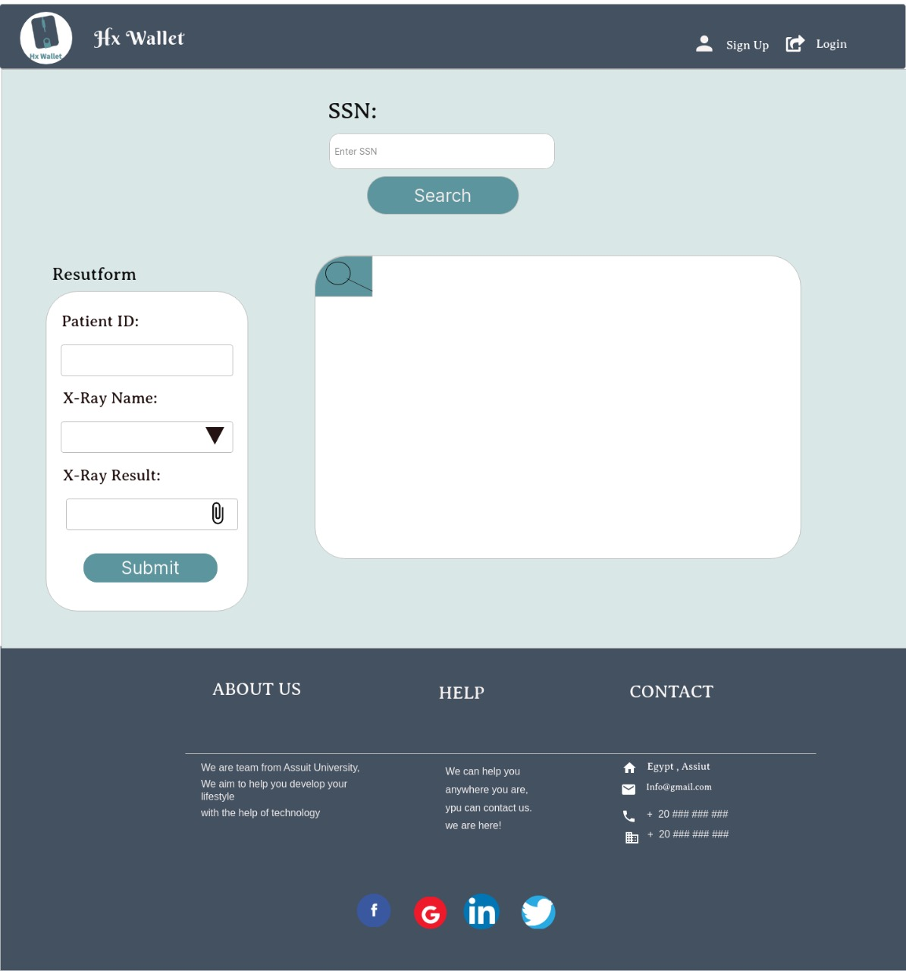

Slide 16
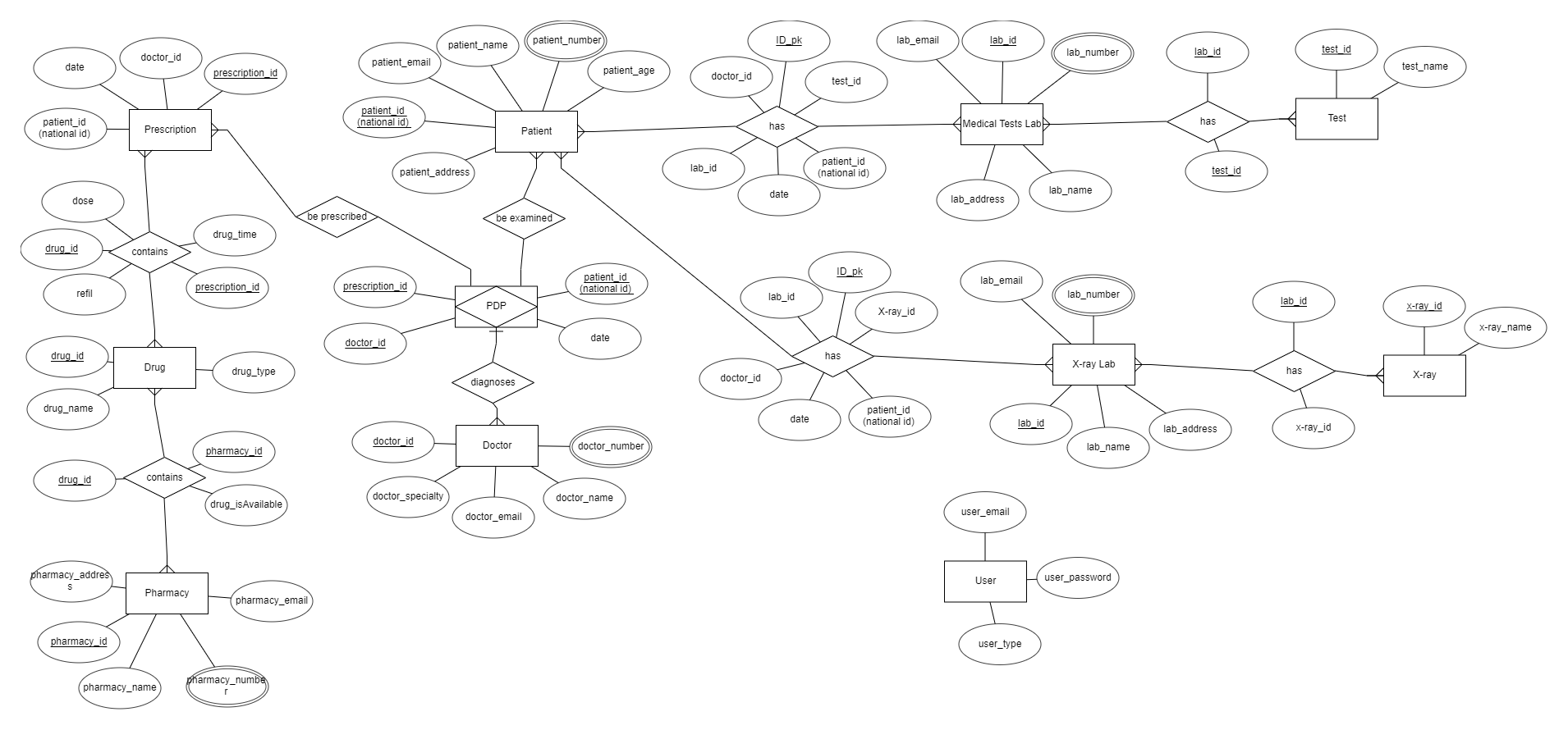

Slide 17
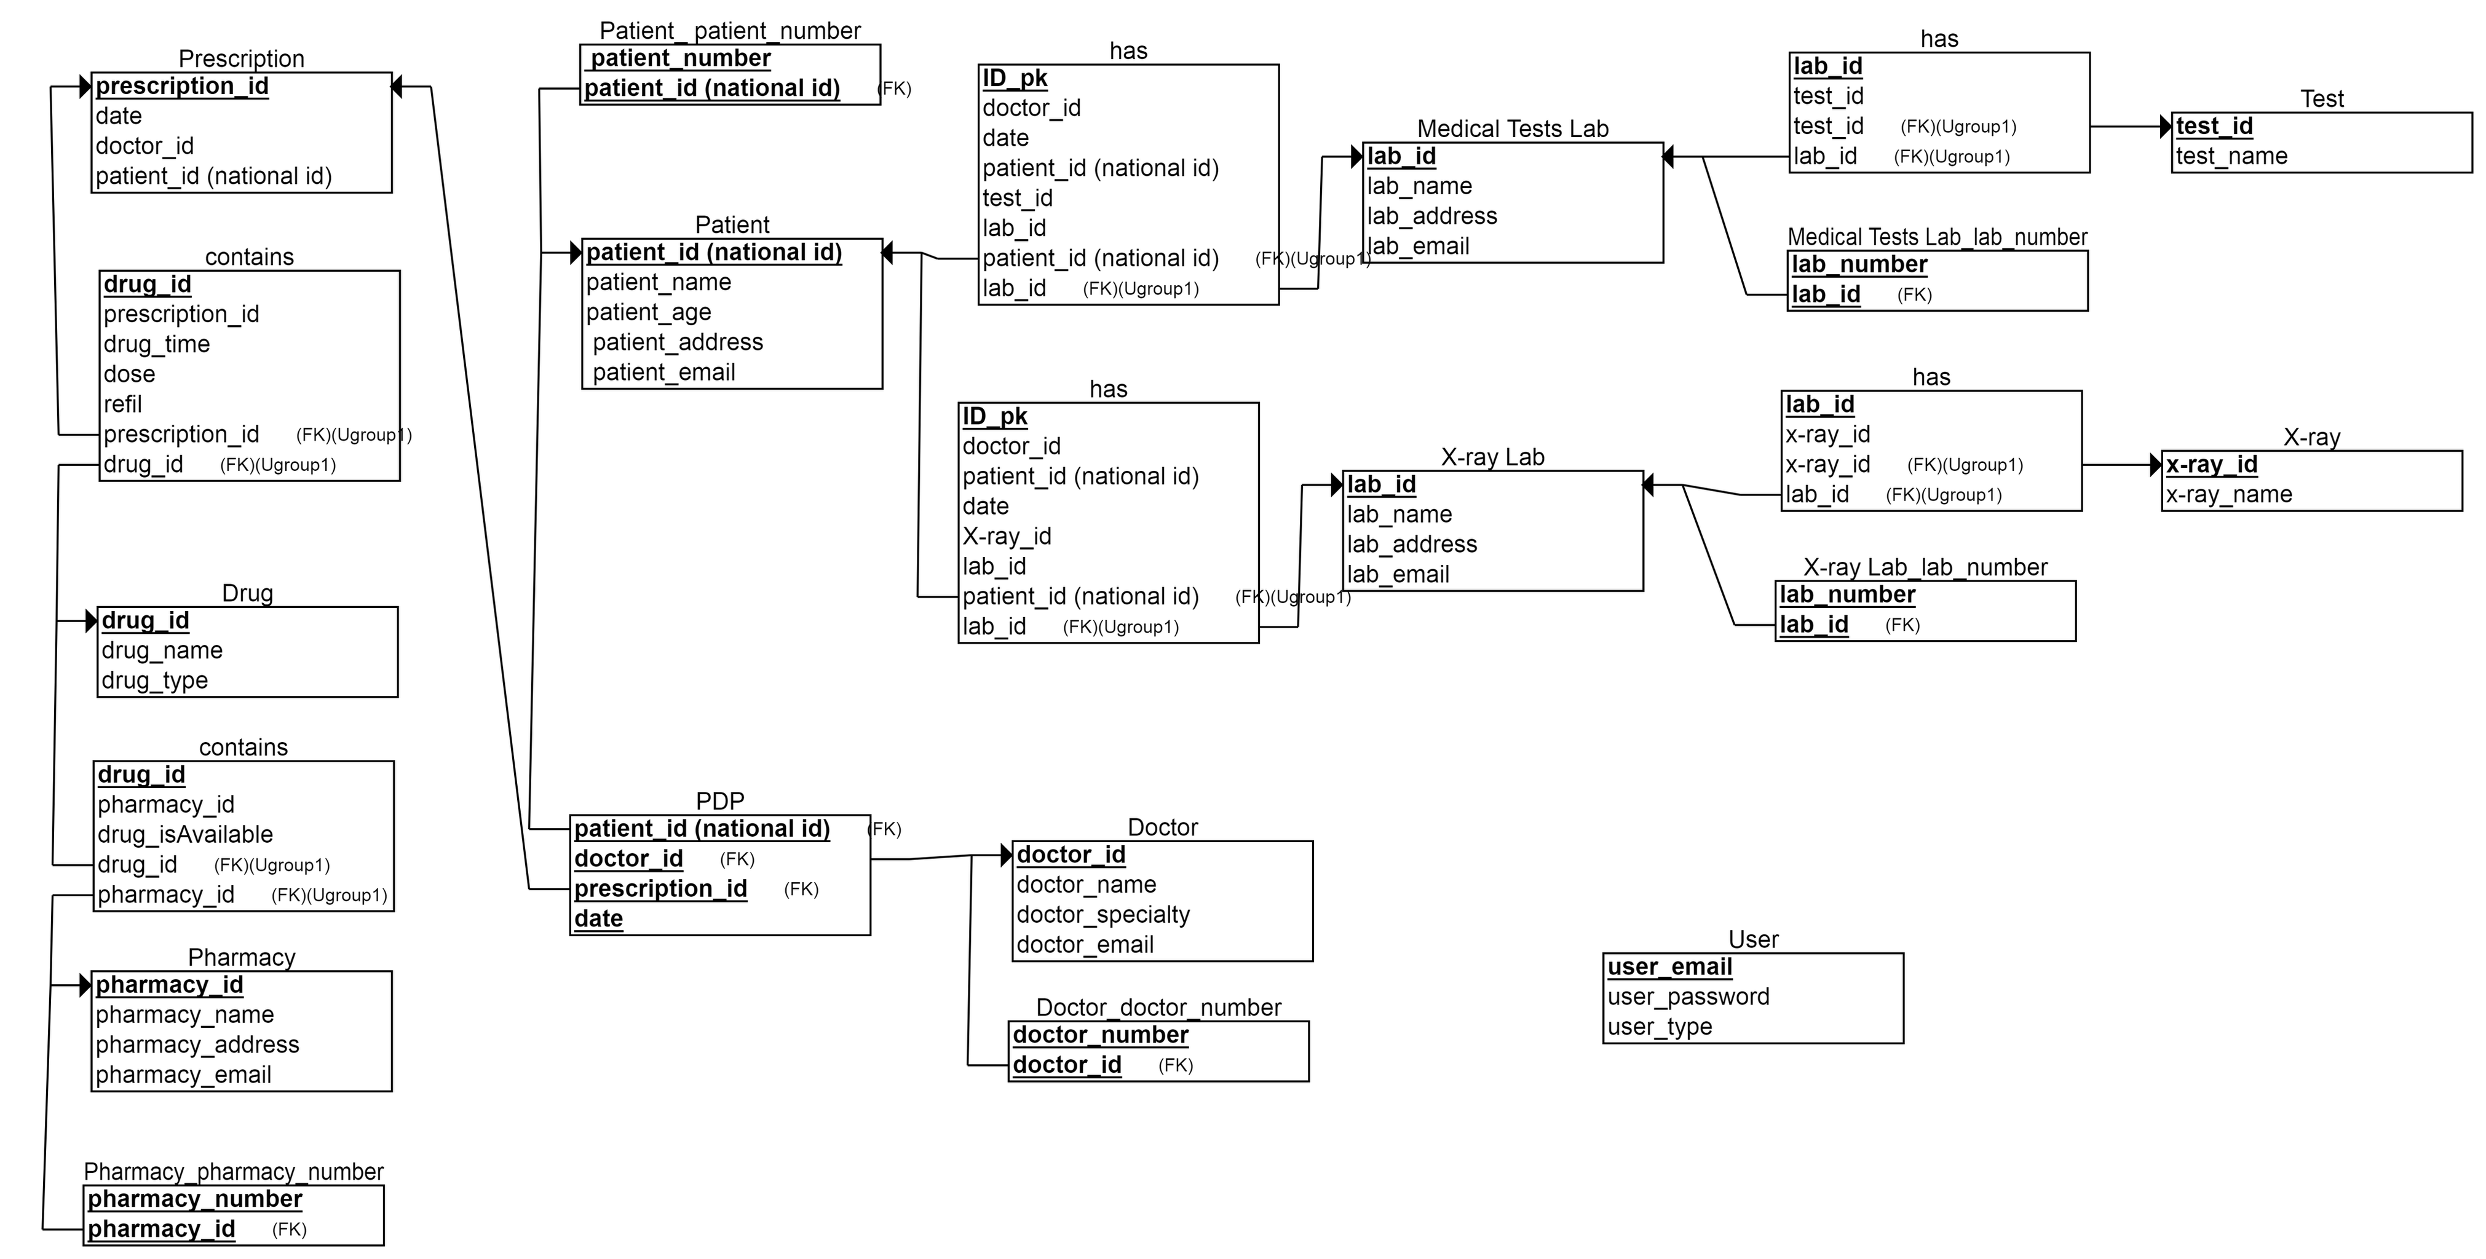

Slide 18
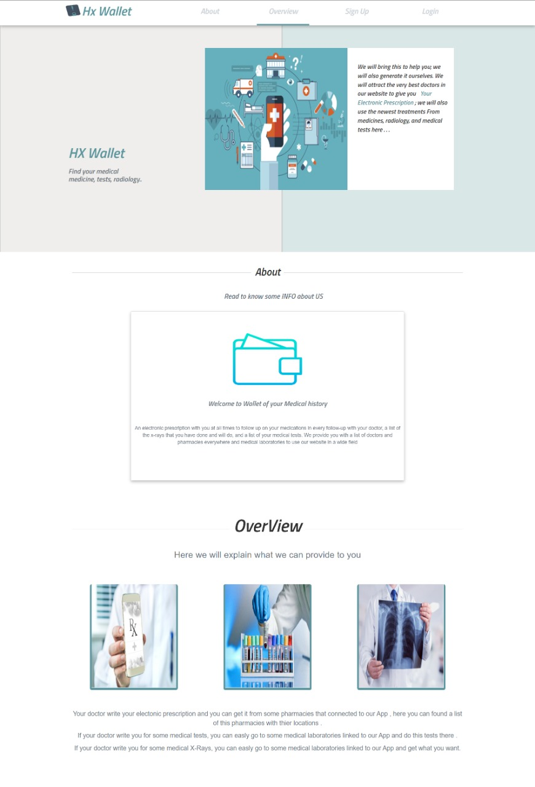

Slide 19
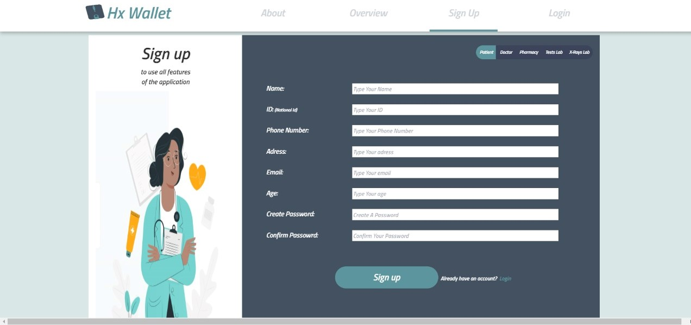

Slide 20
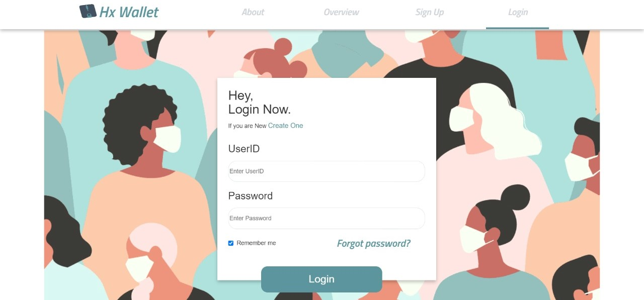

Slide 21
Back Part

Slide 22
Learning Source and What
We have learned :-
.NET track[MVC , entity framework ,LINQ]
web API with code first approach
Source : from ITI tracks and YouTube

Slide 23
Sign Up Page
we check the Model State
if it is not Valid
then we return “Bad Request” with the Model State
else in case of valid state we sign up the user and we insert his info into DB
The password is encrypted before it is stored

Slide 24
LogIn Page
Token Tries to check whether the user is already registered on the website or not
in case of authorization user will log into the website
else 401 (Unauthorized) status code will be the result

Slide 25
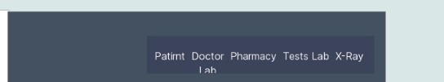
Choose what type of users is you
Each ype of users have a specific form fill it and click sign up
By entering your info you are loged in and you directed to one of pages

Slide 26
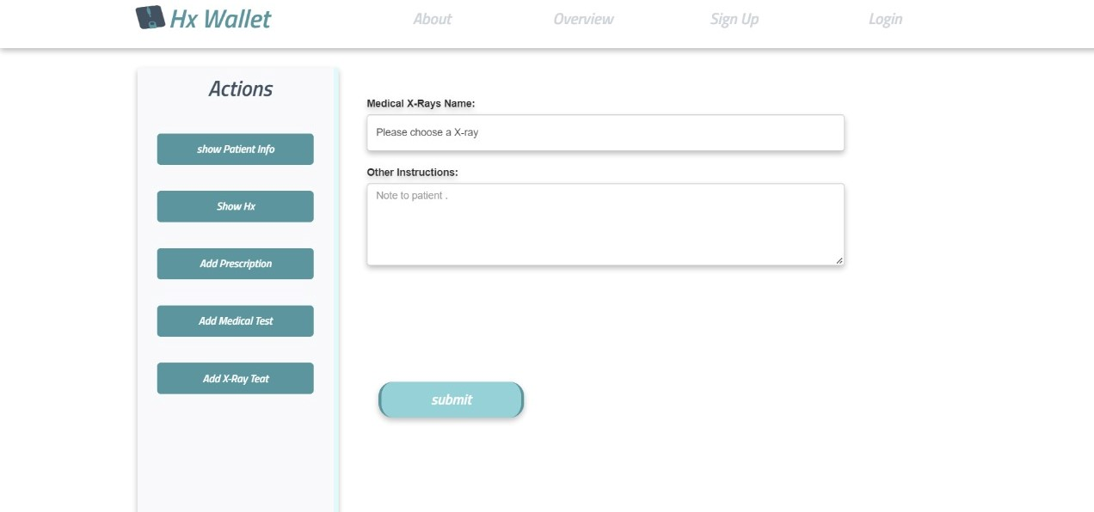
Doctor Page

Slide 27
Patient Page

Slide 28
Pharmact Page

Slide 29
Test Lab Page

Slide 30
X-ray Lab Page

Slide 31
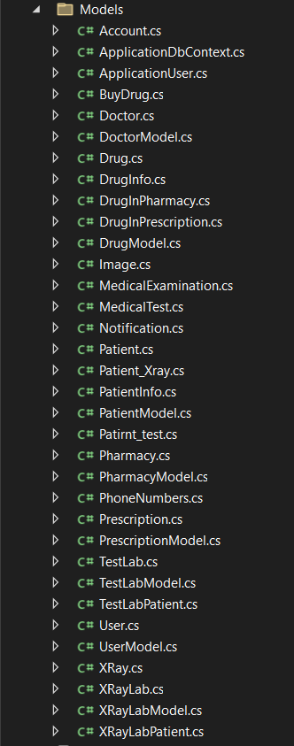
Classes
we have made:-
model classes for each user( doctor, patient, pharmacy, X_RayLab, TestLab)
and classes that map on model classes

Slide 32
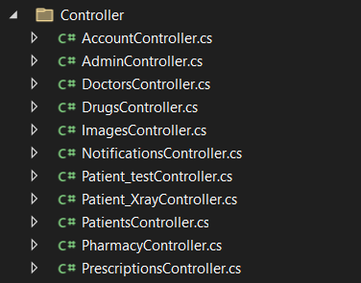
Controllers

Slide 33
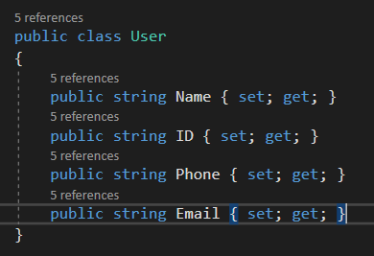
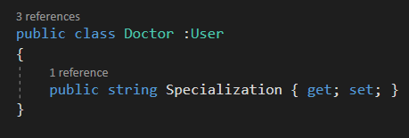
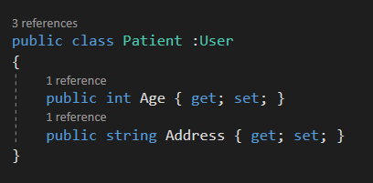
User class
user class is a base class for both these classes:-
Doctor
Patient
TestLab
Pharmacy
X_RayLab

Slide 34
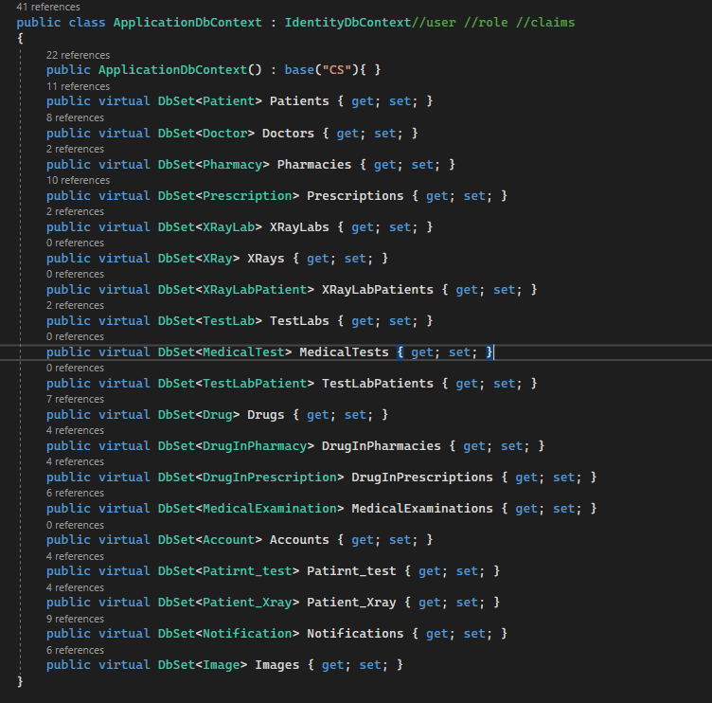
ApplicationDBContext.cs

Slide 35
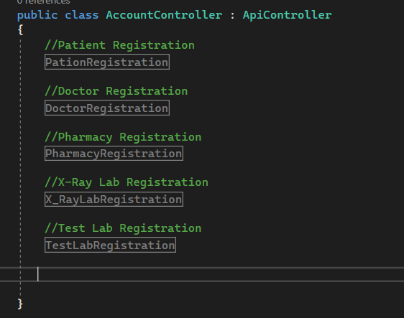
Account Controller

Slide 36
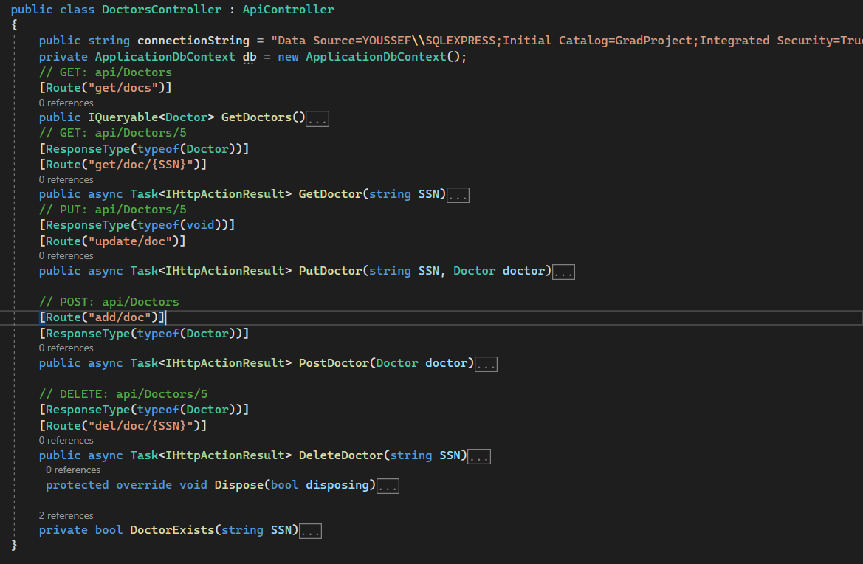
Doctors Controller

Slide 37
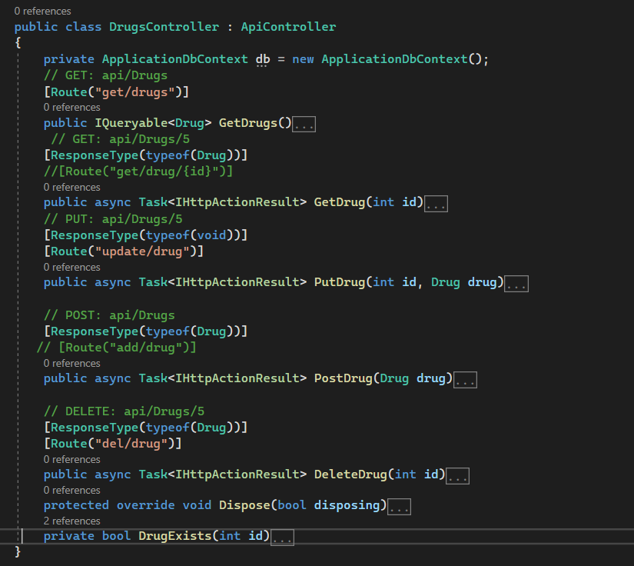
Drug Controller

Slide 38
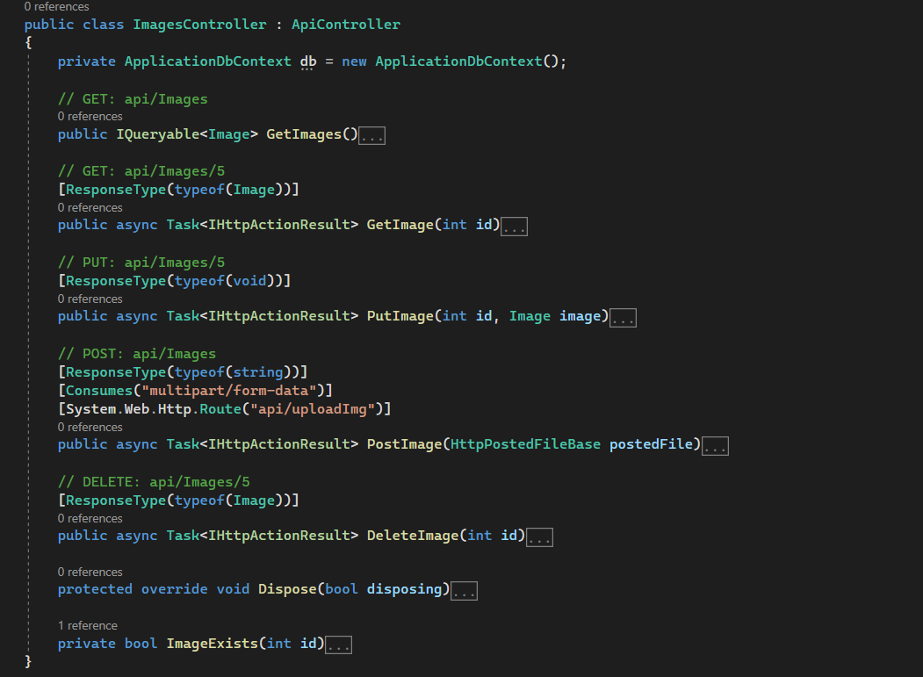
Image Controller

Slide 39
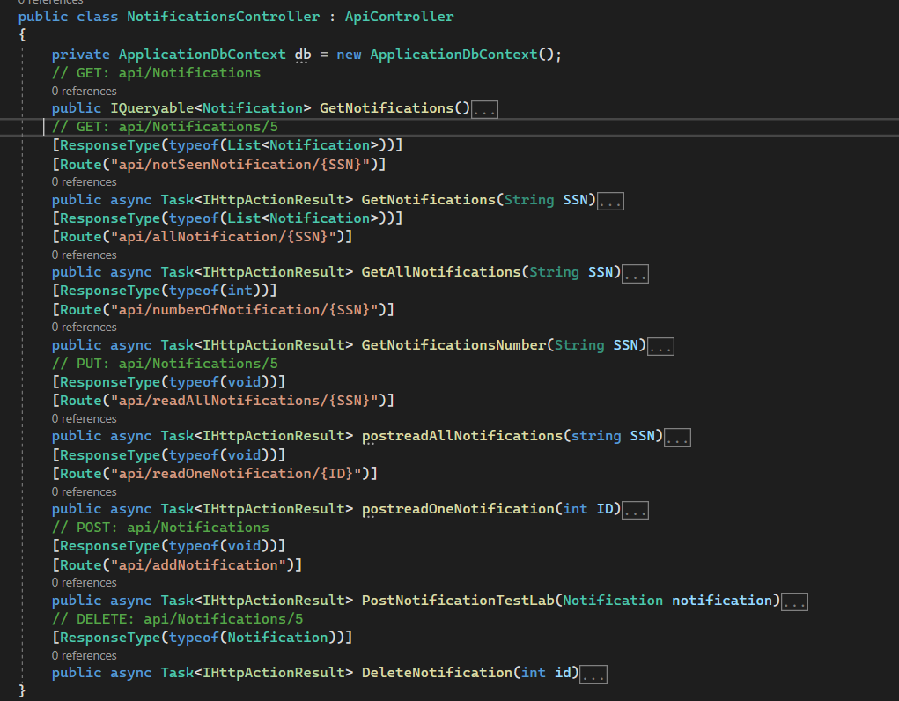
Notifications Controller

Slide 40
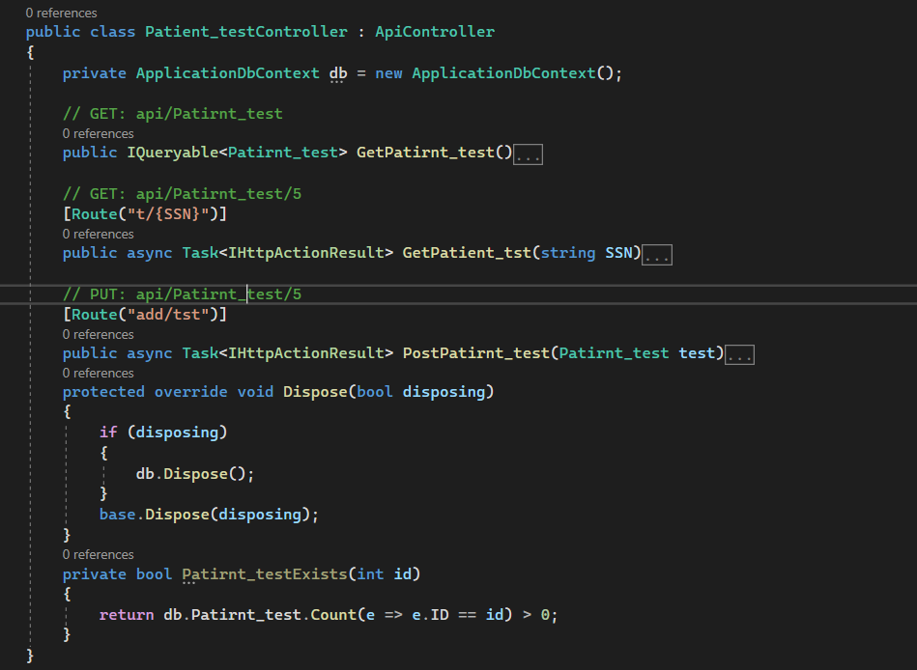
Patient_test Controller

Slide 41
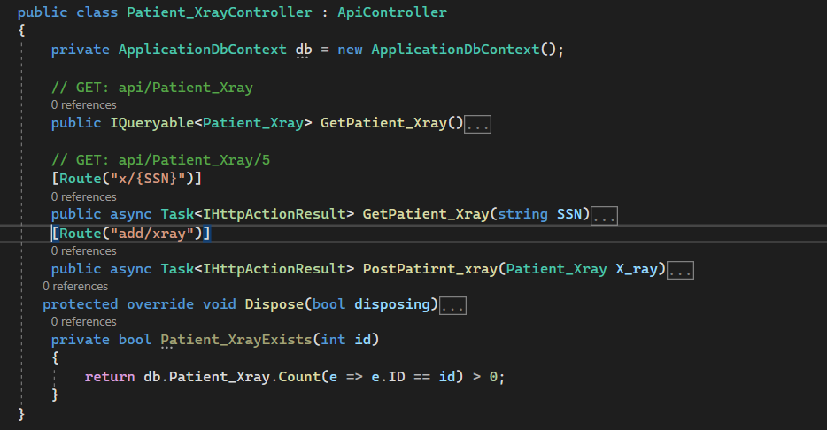
Patient_Xray Controller

Slide 42
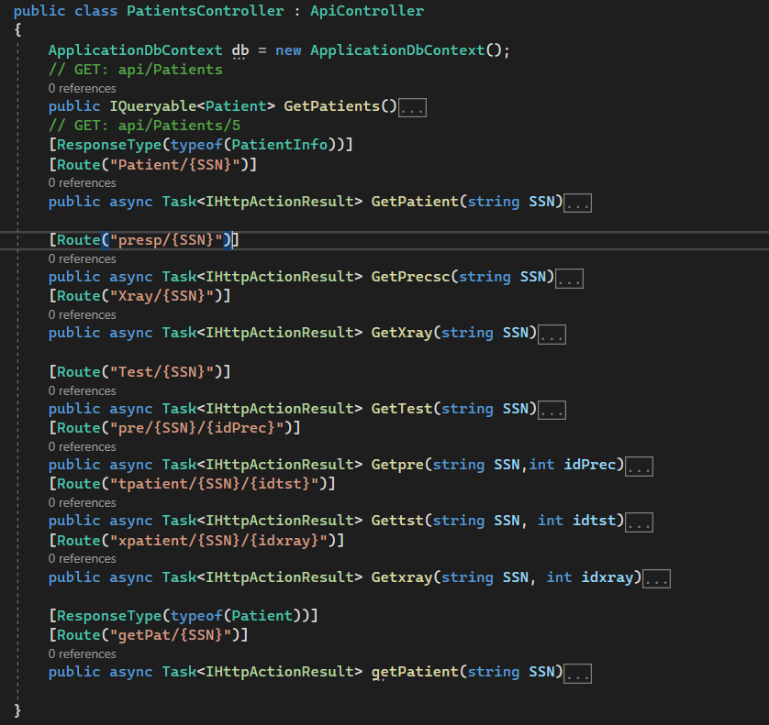
Patient Controller

Slide 43
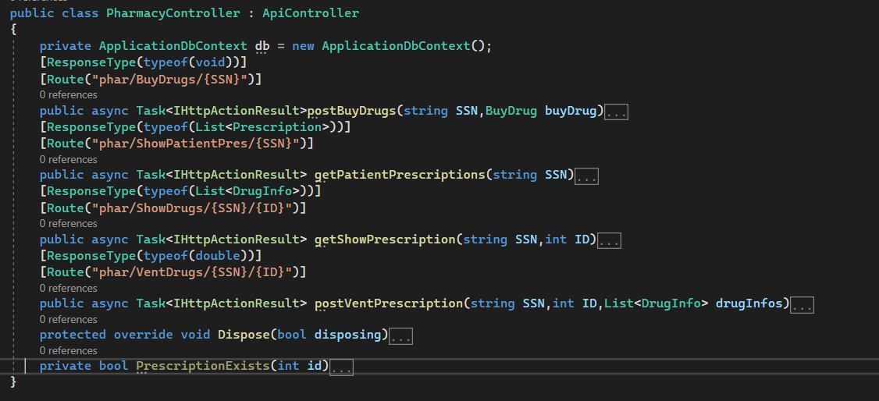
Pharmacy Controller

Slide 44
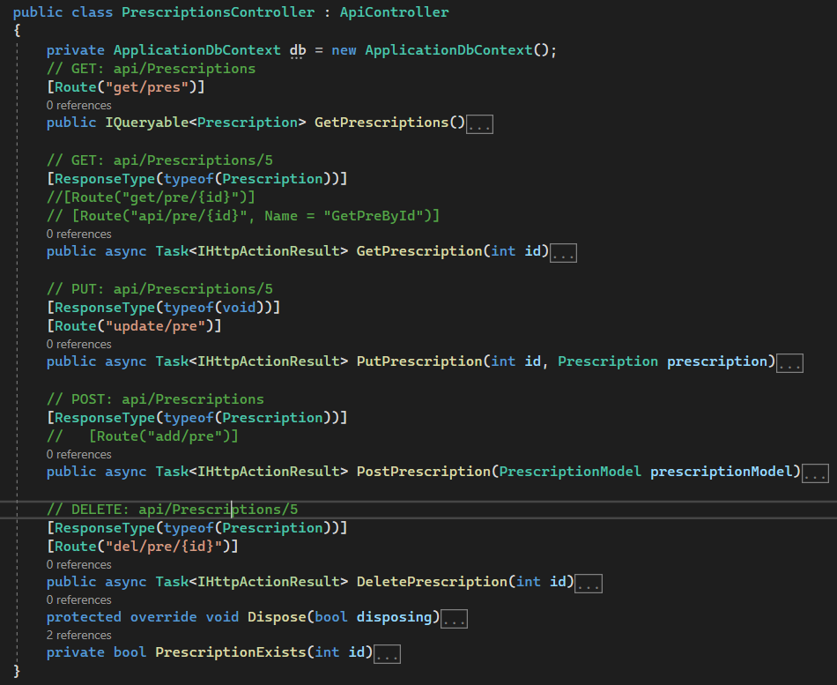
Prescriptions Controller

Slide 45
Thanks.

